Slide 1
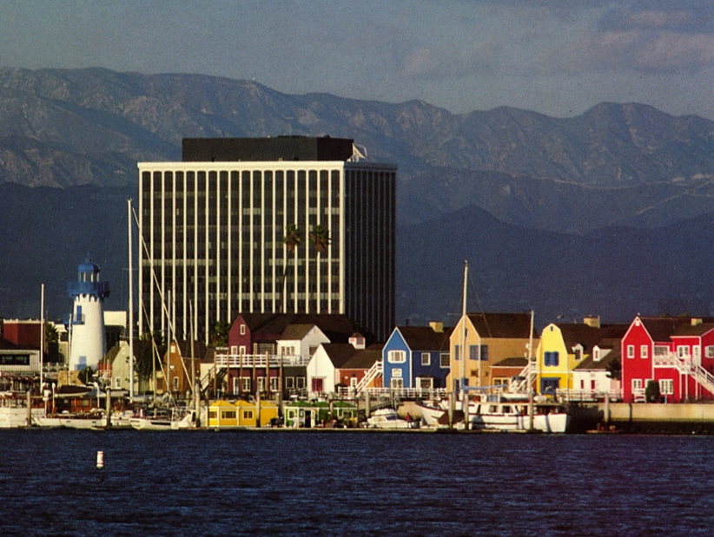



Lessons Learned in Building Linked Data for the American Art Collaborative
Craig Knoblock
University of Southern California
Information Sciences Institute
Pedro Szekely, Eleanor Fink, David Newbury, Robert Sanderson, Duane Degler, Kate Blanch, Sara Snyder, Nilay Chheda, Nimesh Jain, Ravi Raju Krishna, Nikhila Begur Sreekanth, and Yixiang Yao

Slide 2
Project Goals
Launch the American Art Collaborative
Consortium of 14 American art museums
Explore the use of Linked Data to make their data available for research, education, and outreach
Build 5* Linked Data for the museums
Map the data about artwork and artists to a common ontology
Link the data to other resources
Create/extend tools to support the construction of Linked Data
Create applications using the data

Slide 3
Outline
Mapping the data
Linking the entities
Using the Linked Data
Related Work & Discussion

Slide 4
Mapping the Data
Challenges
Museums have the data in wildly different formats and use different schemas
The CIDOC-CRM ontology is a large and complicated ontology
Approach
Use Github to organize all of the data, mappings, and resulting RDF
Use Karma to create the mappings of each dataset
Trained a team of USC students to apply the tools to the datasets

Slide 5
Use Karma to Map the Data to the Ontology

Slide 6
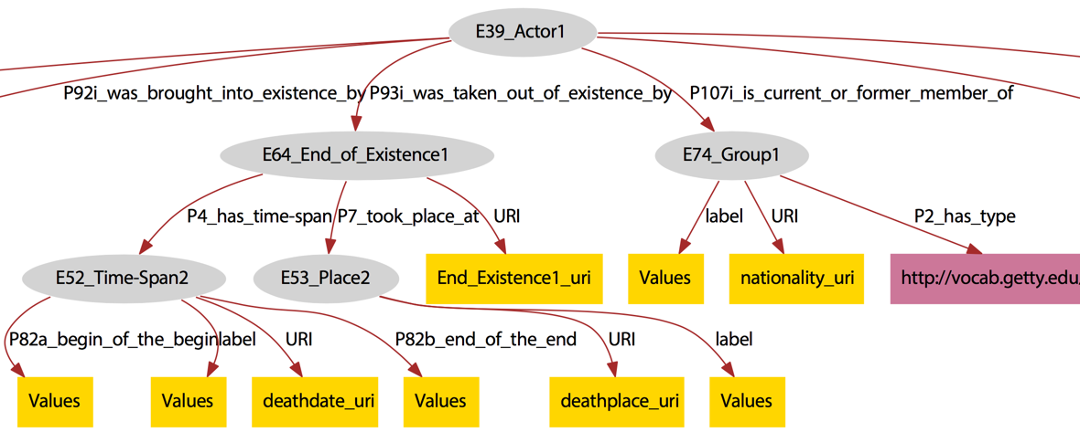
Example Model of Actor for Amon Carter

Slide 7
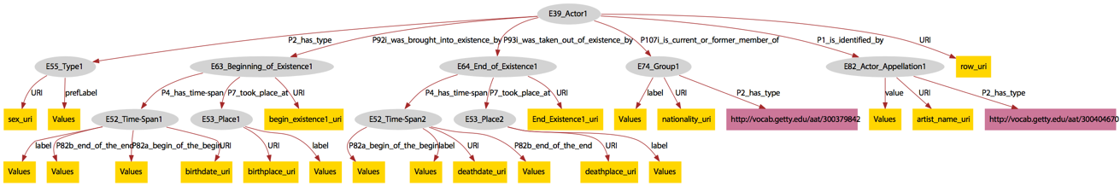
Complete Model of Actor for Amon Carter

Slide 8
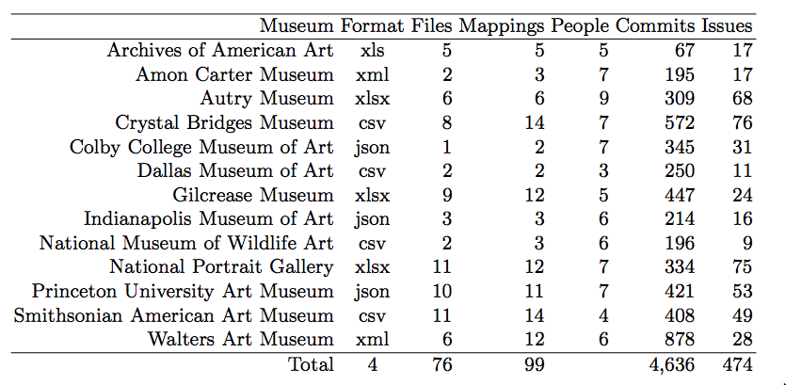
AAC Data Statistics

Slide 9
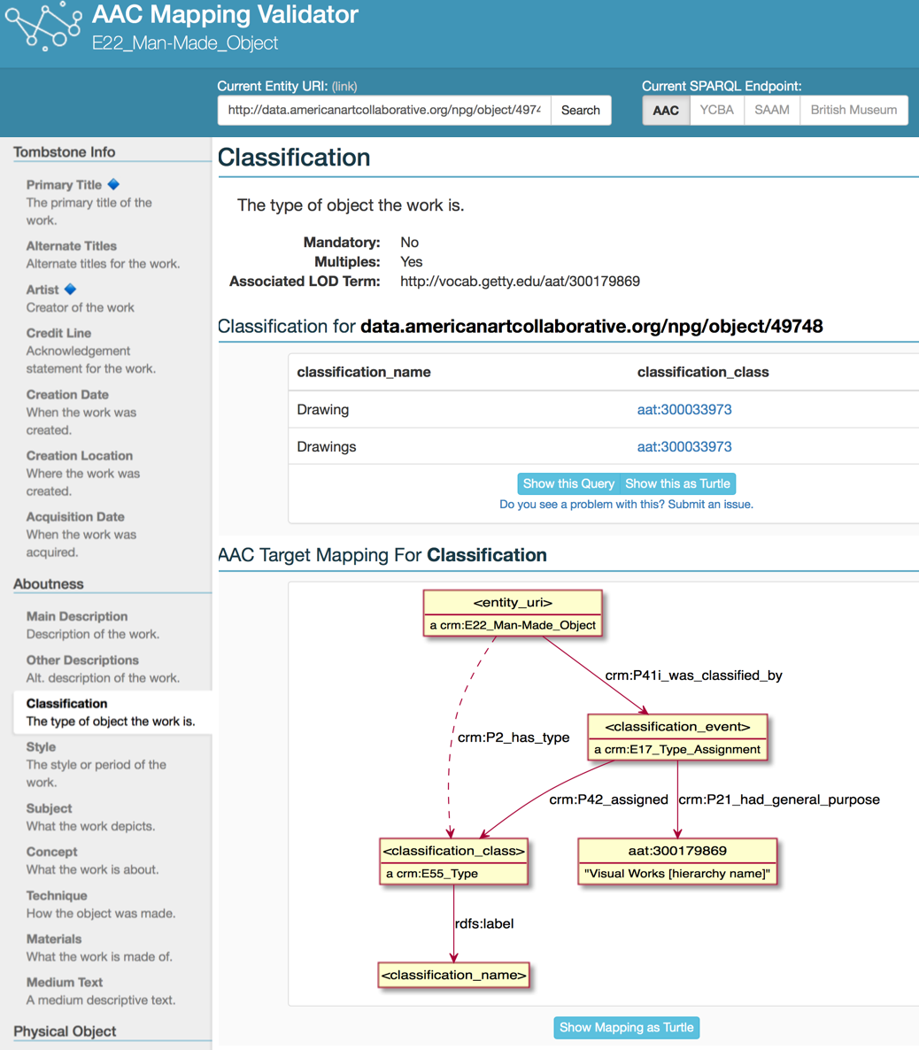
AAC Target Mappings

Slide 10
AAC Mapping Validator

Slide 11
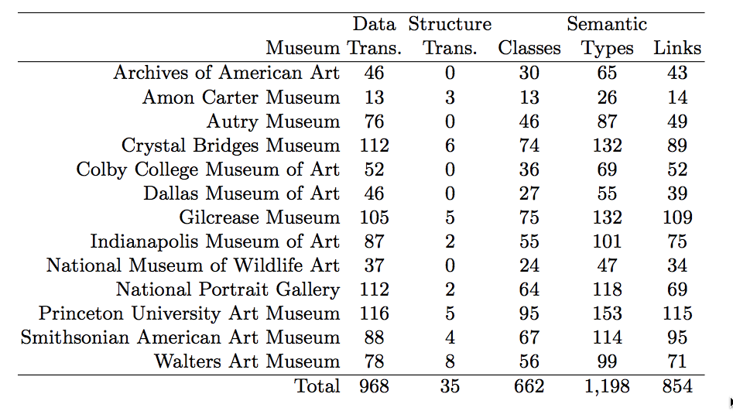
Statistics on the Mappings

Slide 12
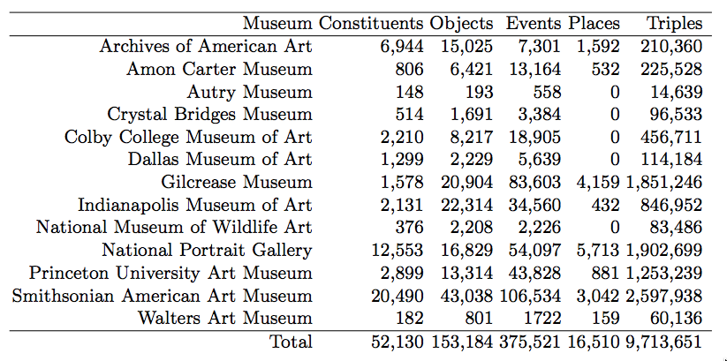
Statistics on What Was Mapped

Slide 13
Mapping Lessons
Lesson 1: Reproducible Workflows
Allow museums to export raw data from their collection management systems
Lesson 2: Shared Repository
Github was invaluable for managing all the data and mapping files
Lesson 3: Data Clearning
Significant data cleaning was required
Integrated as part of the data processing workflow in Karma
Lesson 4: Mapping Inconsistencies
Validation tool was critical to completing a consistent set of mappings
Lesson 5: Expert Review
The outside review was crucial in identifying and resolving mapping inconsistencies

Slide 14
Linking the Data
Goals
Link the entities in the museum data to other resources
Capability for museums to curate the automatically generated links
Demonstration: linking artists to Getty ULAN
Approach
Attempted to use existing linking tools, but they either didn’t scale or students found them difficult to configure
Wrote a specialized script to generate high recall & precision candidates
Built a link review tool that the museums used to curate their links

Slide 15
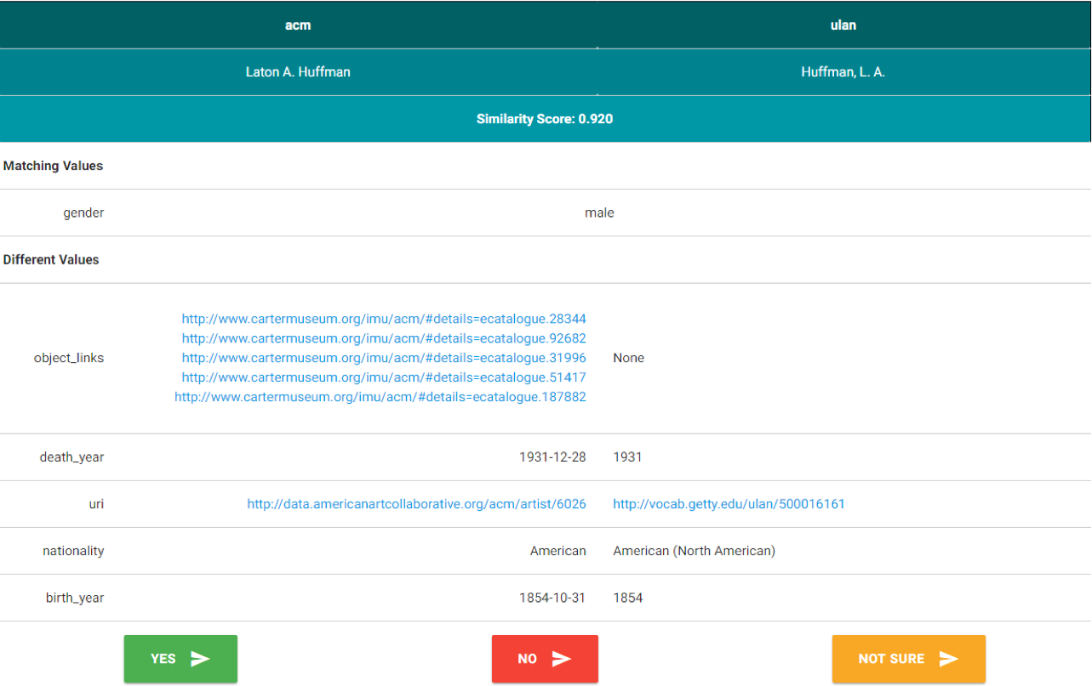
Link Review Screenshot

Slide 16
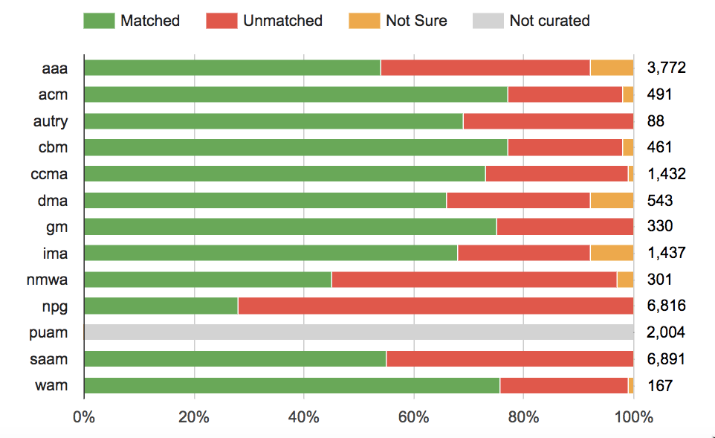
Screenshot with Linking Review Results

Slide 17
Summary Statistics on the Linking Process
Number of constituents in data: 42,685
Previously existing links to ULAN: 3,349
Linking based on previously existing links:
Precision: .96
Recall: .88
F1-measure: .92
Candidate matches: 24,733
Incorrect links in museums datasets: 19
New links to ULAN: 9,357
Incorrect links after review: 2
Previously existing links not discovered: 136

Slide 18
Lessons Learned on Linking
Lesson 6: Linking Tools
Difficult to configure and use the existing linking tools and get them to scale to large datasets (e.g., ULAN, DBPedia, & VIAF)
We need easy to work with and scalable libraries for linking tasks
Lesson 7: Manual Review
Users are willing to invest significant time and energy to ensure the final data is accurate
The museums reviewed almost 25K links!
A few weeks of effort almost tripled the number of links to ULAN

Slide 19
Using the Data: The Browse Application

Slide 20
Using the Data: Under Development

Slide 21
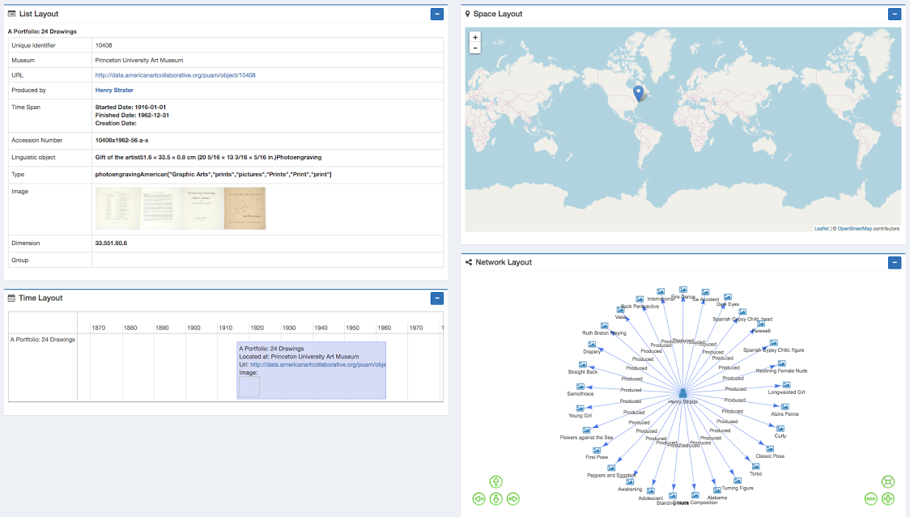
SemUI Visualization [Giunchiglia, Ojha, & Das, ICSC 2017]

Slide 22
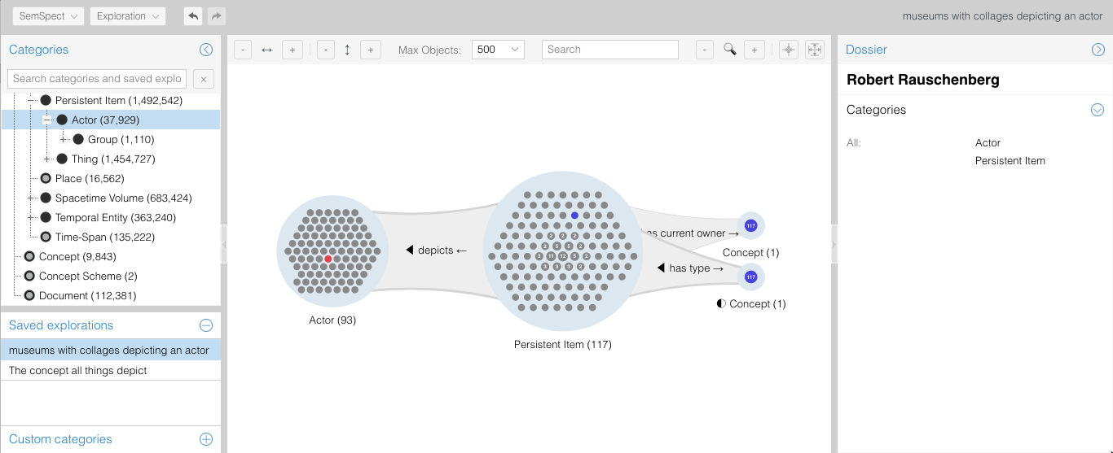
SemSpect (http://aac.semspect.de/) Thorsten Liebig (derivo)

Slide 23
Lessons Learned in Using the Data
Lesson 8: Visualization
Easy to understand visualization is needed for non-technical users
Lesson 9: Simple Schema
CRM ontology may be useful for research, but challenging for applications
Created a set of SPARQL queries to create JSON objects
Loaded the objects into Elasticsearch for complex analysis

Slide 24
Related Work
Consortiums of museums
Europeana – 1500 cultural heritage institutions, 17 million items
CHIN – 8 Canadian museums, 85,000 items
LODAC – 114 museums in Japan
Published a fixed schema and mapped all museums/institutions to the schema
Organizations using the CRM ontology
Research space (British museum & Yale Center for British Art)
Pharos – 14 historical photo archives
Each organization is responsible for publishing their own data to CRM
Mapping data to CRM
X3ML – maps XML data to CRM using manually written rules
Linking
Silk, Dedup, etc. – focus is on automatic linking, but no curation of the links
Mix’n’match, OpenRefine – support link review, but targets highly technical users

Slide 25
Discussion
Collaborated with 14 American art museums to publish 5* Linked Data
Created a set of tools to create the linked data
Karma – clean and map the data, publish directly to Gitub
Mapping Validation tool – review the mappings to ensure consistency
Karma execution tool – applies Karma mappings and published both RDF and JSON-LD directly to Github
Link Review tool – allows non-technical users to quickly and easily review links to other sources
Browse application – allows museum staff, art historians, and the general public to verify and explore the data

Slide 26
Success?
14 additional museums have now released their data as linked data
Three museums have already learned how to use the tools to create their own mappings
Indianapolis Museum of Art
Smithsonian Archives of American Art
Colby College Museum of Art
Researchers outside the project have applied their visualization tools to the data
Sajan Raj Ojha (Univ. of Trento): SemUI
Thorsten Liebig (derivo): SemSpect http://aac.semspect.de/

Slide 27
Future Work
Automate the addition of new museums to the AAC
Gather, map, and link the data directly form their online web pages
Extend the types of information supported
E.g., exhibition data & bibliographies
Improve the ability in Karma to automate complex mappings
Link the existing data to other sources
E.g., VIAF, Geonames, & DBpedia
Build a library of linking functions to support easy and scalable linking

Slide 28
More Info
Demo Tonight: D44 (and SemSpect D14)
More info:
Karma: karma.isi.edu
AAC: americanartcollaborative.org
Github: github.com/american-art
We are recruiting/hiring at all levels: Phd students, Postdocs, and Full-time researchers
Come see me if interested
Go to my FAQ at http://isi.edu/~knoblock for link to apply
Thanks to the Mellon Foundation & Institute of Museum and Library Services for their financial support of this project

Slide 29
Thanks!

